Slide 1

Hybrid ISA Student Review
PESU Academy

Slide 2

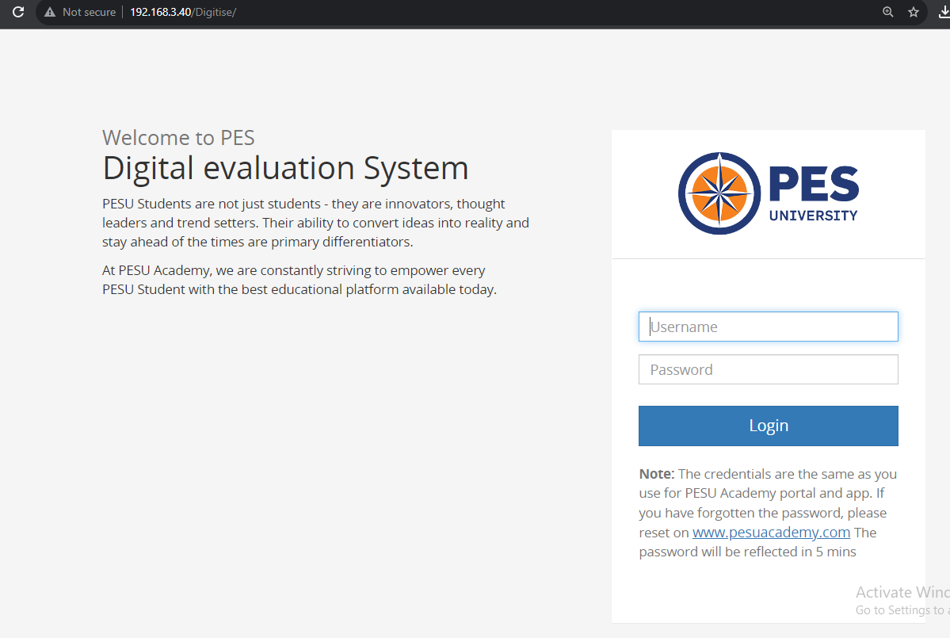
Digitise – Review Login
Login to link - http://192.168.3.40/Digitise (RR Campus) or https://rr.pesuacademy.com/Digitise (EC Campus).
Login using your PESUAcademy credentials. (Username - SRN/PRN and your PESUAcademy password)
Note : Please remember your academy passwords, alternative passwords will not be provided.

Slide 3
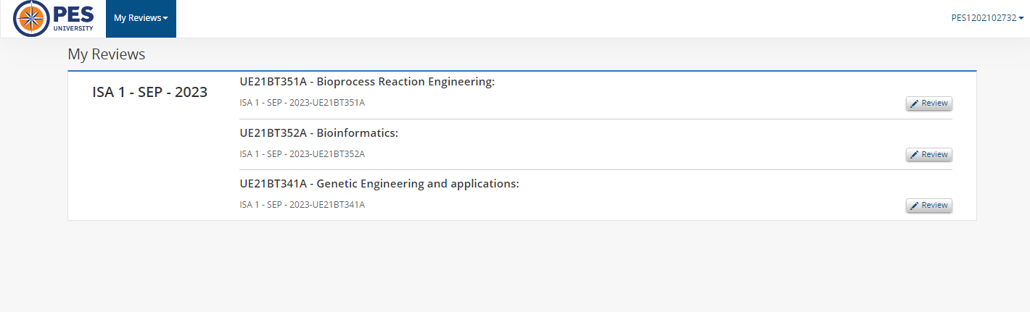
Business
Review Home Screen
After Logging in, click on Review tab for respective subjects to view the response.

Slide 4
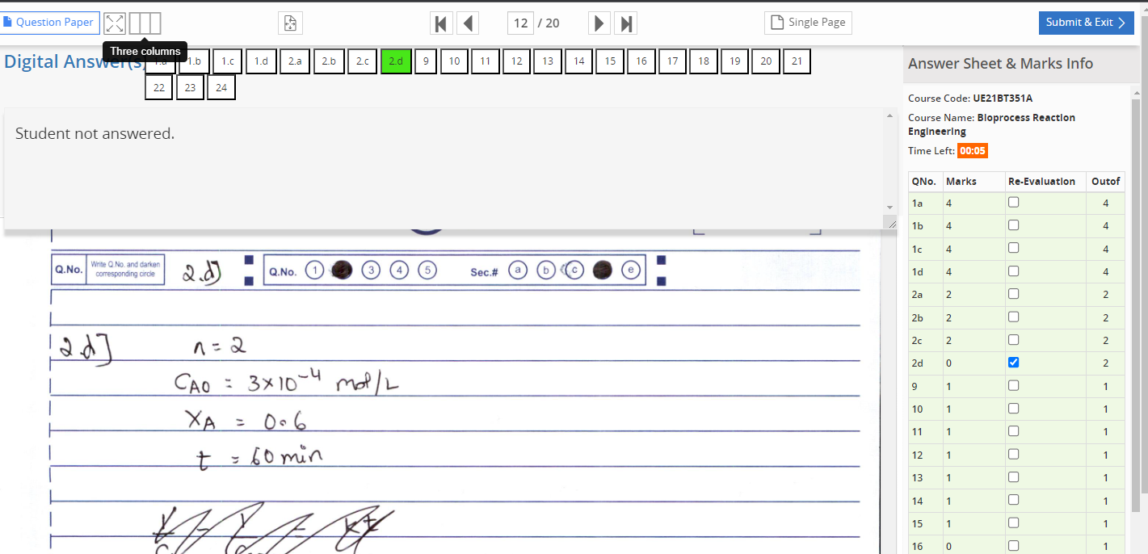
Review Screen
Click on Three Columns or Question paper to view the Scheme & solutions.

Slide 5
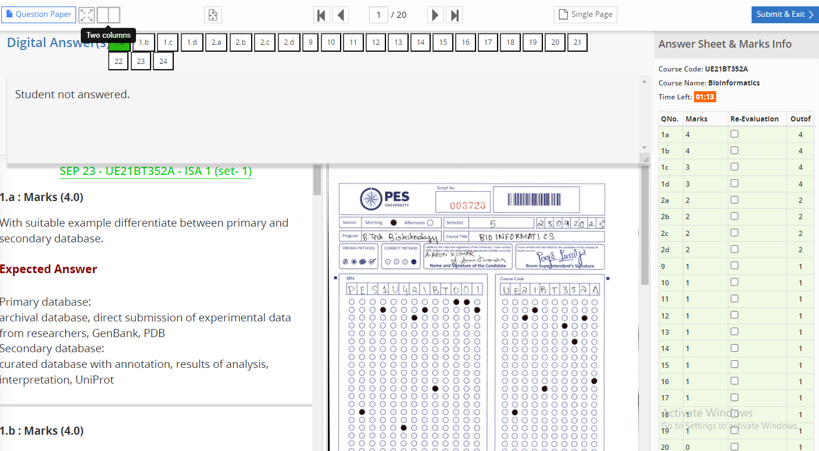
Scheme & Solution in Three Columns view

Slide 6
Apply for Re-Evaluation
Click on the check box corresponding to the Question No. to apply for Re-Evaluation.

Slide 7
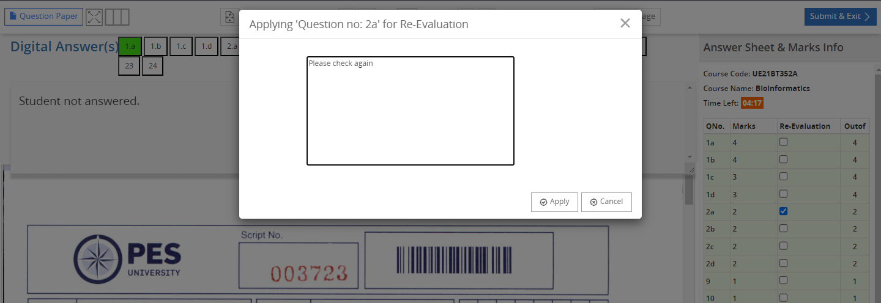
Comment Box
Add your comments & click on apply.

Slide 8
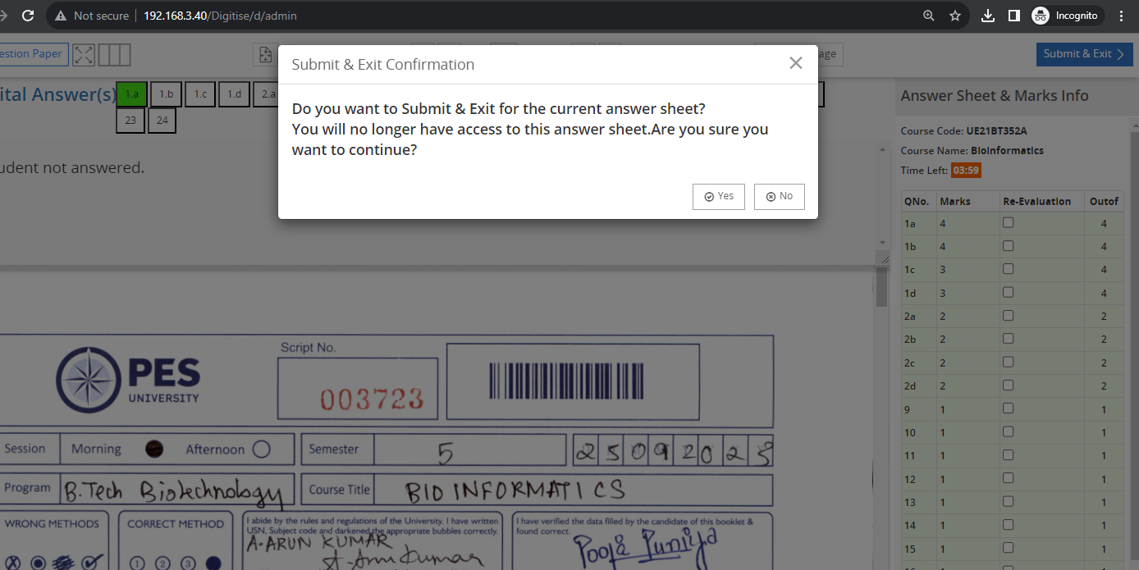
Click on Yes to submit.
Confirmation Screen

Slide 9
Points to be remembered
During the student review process, you will have a five-minute time limit for each subject.
Once you submit it, you will not be able to review the answer script again.
Applying for Re-evaluation is applicable only for descriptive type questions. If any discrepancy in MCQ’s, it should be reported to subject faculty.
DO NOT refresh the page while reviewing the answer scripts, it will be submitted automatically.
For any technical issues kindly contact the lab instructor immediately.
If you are unable to review the answer script, please check with the COE Team or Accounts department (Fee due).

Slide 10
Thank You !!

